Slide 1
Theory of Algorithms
Introduction

Slide 2
Lectures
Wednesdays, 16:30 – 19:50
Feel free to interrupt and ask questions at any time! (except today)
Latvian speakers are advised to join the same course by A.Ambainis
(and all other courses by him)

Slide 3
Grading
TBA

Slide 4
Useful links
Sources
http://home.lu.lv/~sd80008/algo
Michael Sipser. Introduction to the Theory of Computation.
https://estudijas.lu.lv/ [mostly in Latvian]
Slides from previous years (?)
Recorded lectures, current slides
Contacts
Dmitry Kravchenko
E-mail: dmitrijs.kravchenko@lu.lv
or kravchenko@gmail.com
E-studies: https://estudijas.lu.lv/

Slide 5
Topics covered
Turing machine
Decision problems
Turing machine - a mathematical model for algorithms.
Recursiveness and recursive enumerability.
Halting problem and computational undecidability.
Reductions between computational problems.
Computational complexity
Big O notation
Complexity classes
Polynomial time - model for efficient computability
Class NP - model for efficient checkability
NP-complete problems, reductions between them
Space complexity classes and the connections with time complexity

Slide 6

Some examples of problems
Given a string, determine if it contains substring «LU DF»
Given a graph $G=(V,E)$ and two vertices $u,v∈V$, determine if there is a path from $u$ to $v$
Given a number $n$, determine if $n$ is a prime

Slide 7

Alphabets, words, languages
Alphabet – a finite non-empty set of symbols (letters).
Word – a finite string of letters from an alphabet
Operations
$x=aabc$, $y=bb$ – words in alphabet $Γ$ (also in $Σ_{1},Σ_{3}$)
Concatenation: $xy=aabcbb$, Iteration: $x^{k}=\underset{k \text{times}}{\underbrace{xxx…x}}$
Length: $\left|x\right|=4$, $\left|y\right|=2$, $\left|xy\right|=6$
Number of occurences of $a$ in $x$: $|{\left.​x\right|}_{a}=2$, ${\left|y\right|}_{a}=0$, ${\left|x\right|}_{b}=1$, ${\left|xy\right|}_{b}=3$
Indexing: if $\left|x\right|=n$, then $x=x_{1}x_{2}…x_{n}$ ($∀i x_{i}∈Σ$)
The empty word $ε$
$\left|ε\right|=0$
$∀x∈Σ^{∗} εx=xε=x$
$ε$ is a word in every alphabet
The set of all finite words in $Σ$ is denoted by $Σ^{∗}$.
For example, ${\left\{0,1\right\}}^{∗}=\left\{ε,0,1,00,01,10,11,000,001,010,011,100,…\right\}$
$Σ^{k}$ denotes the set of all words from $Σ$ with length $k$
Language is a set of words. $L⊆Σ^{∗}$ denotes a language over alphabet $Σ$

Slide 8

Alphabets, words, languages
Alphabet – a finite non-empty set of symbols (letters).
Word – a finite string of letters from an alphabet
Operations
$x=aabc$, $y=bb$ – words in alphabet $Γ$ (also in $Σ_{1},Σ_{3}$)
Concatenation: $xy=aabcbb$, Iteration: $x^{k}=\underset{k \text{times}}{\underbrace{xxx…x}}$
Length: $\left|x\right|=4$, $\left|y\right|=2$, $\left|xy\right|=6$
Number of occurences of $a$ in $x$: $|{\left.​x\right|}_{a}=2$, ${\left|y\right|}_{a}=0$, ${\left|x\right|}_{b}=1$, ${\left|xy\right|}_{b}=3$
Indexing: if $\left|x\right|=n$, then $x=x_{1}x_{2}…x_{n}$ ($∀i x_{i}∈Σ$)
The empty word $ε$
$\left|ε\right|=0$
$∀x∈Σ^{∗} εx=xε=x$
$ε$ is a word in every alphabet
The set of all finite words in $Σ$ is denoted by $Σ^{∗}$.
For example, ${\left\{0,1\right\}}^{∗}=\left\{ε,0,1,00,01,10,11,000,001,010,011,100,…\right\}$
$Σ^{k}$ denotes the set of all words from $Σ$ with length $k$
Language is a set of words. $L⊆Σ^{∗}$ denotes a language over alphabet $Σ$

Slide 9

Alphabets, words, languages
$Σ_{1}=\left\{a,b,…,z\right\}$
$Σ_{2}=\left\{0,1\right\}$
$Σ_{3}=\left\{ a, ā, b, … z, ž, A, …, Ž, ␣, ., \left(, \right), …, ! \right\}$
$Σ_{4}=\left\{ ↑ , ↓ , → , ← \right\}$
$Γ =\left\{a,b,c\right\}$
Alphabet – a finite non-empty set of symbols (letters).
Word – a finite string of letters from an alphabet
Operations
$x=aabc$, $y=bb$ – words in alphabet $Γ$ (also in $Σ_{1},Σ_{3}$)
Concatenation: $xy=aabcbb$, Iteration: $x^{k}=\underset{k \text{times}}{\underbrace{xxx…x}}$
Length: $\left|x\right|=4$, $\left|y\right|=2$, $\left|xy\right|=6$
Number of occurences of $a$ in $x$: $|{\left.​x\right|}_{a}=2$, ${\left|y\right|}_{a}=0$, ${\left|x\right|}_{b}=1$, ${\left|xy\right|}_{b}=3$
Indexing: if $\left|x\right|=n$, then $x=x_{1}x_{2}…x_{n}$ ($∀i x_{i}∈Σ$)
The empty word $ε$
$\left|ε\right|=0$
$∀x∈Σ^{∗} εx=xε=x$
$ε$ is a word in every alphabet
The set of all finite words in $Σ$ is denoted by $Σ^{∗}$.
For example, ${\left\{0,1\right\}}^{∗}=\left\{ε,0,1,00,01,10,11,000,001,010,011,100,…\right\}$
$Σ^{k}$ denotes the set of all words from $Σ$ with length $k$
Language is a set of words. $L⊆Σ^{∗}$ denotes a language over alphabet $Σ$

Slide 10

Alphabets, words, languages
$Σ_{1}=\left\{a,b,…,z\right\}$
$Σ_{2}=\left\{0,1\right\}$
$Σ_{3}=\left\{ a, ā, b, … z, ž, A, …, Ž, ␣, ., \left(, \right), …, ! \right\}$
$Σ_{4}=\left\{ ↑ , ↓ , → , ← \right\}$
$Γ =\left\{a,b,c\right\}$
Alphabet – a finite non-empty set of symbols (letters).
Word – a finite string of letters from an alphabet
Operations
$x=aabc$, $y=bb$ – words in alphabet $Γ$ (also in $Σ_{1},Σ_{3}$)
Concatenation: $xy=aabcbb$, Iteration: $x^{k}=\underset{k \text{times}}{\underbrace{xxx…x}}$
Length: $\left|x\right|=4$, $\left|y\right|=2$, $\left|xy\right|=6$
Number of occurences of $a$ in $x$: $|{\left.​x\right|}_{a}=2$, ${\left|y\right|}_{a}=0$, ${\left|x\right|}_{b}=1$, ${\left|xy\right|}_{b}=3$
Indexing: if $\left|x\right|=n$, then $x=x_{1}x_{2}…x_{n}$ ($∀i x_{i}∈Σ$)
The empty word $ε$
$\left|ε\right|=0$
$∀x∈Σ^{∗} εx=xε=x$
$ε$ is a word in every alphabet
The set of all finite words in $Σ$ is denoted by $Σ^{∗}$.
For example, ${\left\{0,1\right\}}^{∗}=\left\{ε,0,1,00,01,10,11,000,001,010,011,100,…\right\}$
$Σ^{k}$ denotes the set of all words from $Σ$ with length $k$
Language is a set of words. $L⊆Σ^{∗}$ denotes a language over alphabet $Σ$

Slide 11
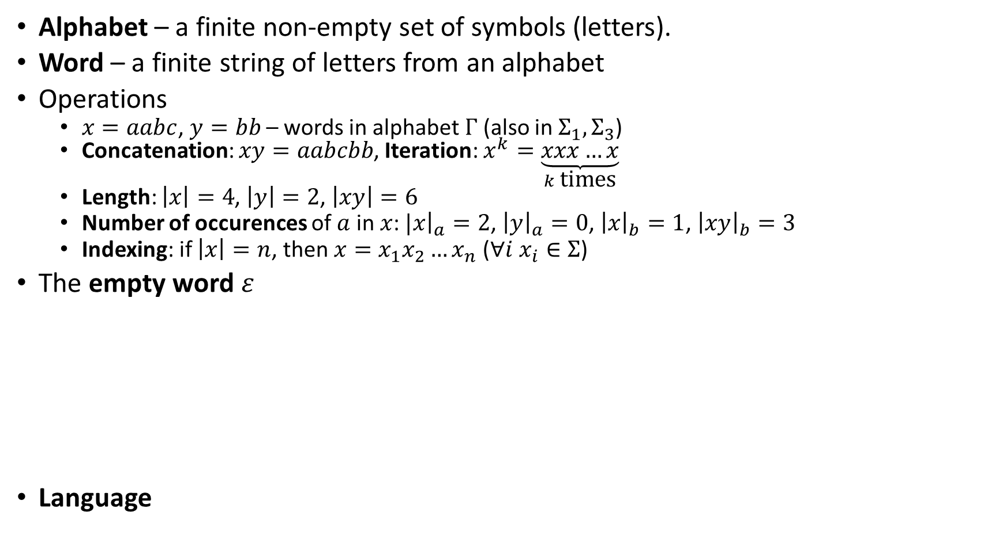
Alphabets, words, languages
$Σ_{1}=\left\{a,b,…,z\right\}$
$Σ_{2}=\left\{0,1\right\}$
$Σ_{3}=\left\{ a, ā, b, … z, ž, A, …, Ž, ␣, ., \left(, \right), …, ! \right\}$
$Σ_{4}=\left\{ ↑ , ↓ , → , ← \right\}$
$Γ =\left\{a,b,c\right\}$
Alphabet – a finite non-empty set of symbols (letters).
Word – a finite string of letters from an alphabet
Operations
$x=aabc$, $y=bb$ – words in alphabet $Γ$ (also in $Σ_{1},Σ_{3}$)
Concatenation: $xy=aabcbb$, Iteration: $x^{k}=\underset{k \text{times}}{\underbrace{xxx…x}}$
Length: $\left|x\right|=4$, $\left|y\right|=2$, $\left|xy\right|=6$
Number of occurences of $a$ in $x$: $|{\left.​x\right|}_{a}=2$, ${\left|y\right|}_{a}=0$, ${\left|x\right|}_{b}=1$, ${\left|xy\right|}_{b}=3$
Indexing: if $\left|x\right|=n$, then $x=x_{1}x_{2}…x_{n}$ ($∀i x_{i}∈Σ$)
The empty word $ε$
$\left|ε\right|=0$
$∀x∈Σ^{∗} εx=xε=x$
$ε$ is a word in every alphabet
The set of all finite words in $Σ$ is denoted by $Σ^{∗}$.
For example, ${\left\{0,1\right\}}^{∗}=\left\{ε,0,1,00,01,10,11,000,001,010,011,100,…\right\}$
$Σ^{k}$ denotes the set of all words from $Σ$ with length $k$
Language is a set of words. $L⊆Σ^{∗}$ denotes a language over alphabet $Σ$

Slide 12
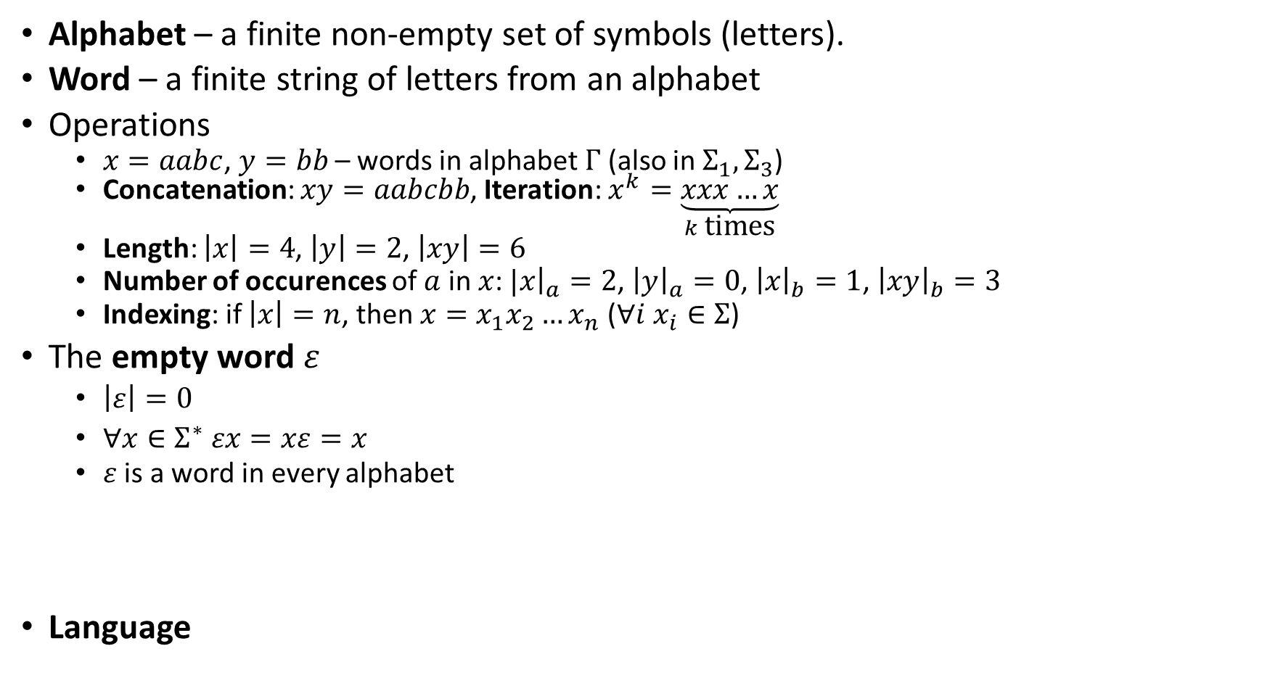
Alphabets, words, languages
$Σ_{1}=\left\{a,b,…,z\right\}$
$Σ_{2}=\left\{0,1\right\}$
$Σ_{3}=\left\{ a, ā, b, … z, ž, A, …, Ž, ␣, ., \left(, \right), …, ! \right\}$
$Σ_{4}=\left\{ ↑ , ↓ , → , ← \right\}$
$Γ =\left\{a,b,c\right\}$
Alphabet – a finite non-empty set of symbols (letters).
Word – a finite string of letters from an alphabet
Operations
$x=aabc$, $y=bb$ – words in alphabet $Γ$ (also in $Σ_{1},Σ_{3}$)
Concatenation: $xy=aabcbb$, Iteration: $x^{k}=\underset{k \text{times}}{\underbrace{xxx…x}}$
Length: $\left|x\right|=4$, $\left|y\right|=2$, $\left|xy\right|=6$
Number of occurences of $a$ in $x$: $|{\left.​x\right|}_{a}=2$, ${\left|y\right|}_{a}=0$, ${\left|x\right|}_{b}=1$, ${\left|xy\right|}_{b}=3$
Indexing: if $\left|x\right|=n$, then $x=x_{1}x_{2}…x_{n}$ ($∀i x_{i}∈Σ$)
The empty word $ε$
$\left|ε\right|=0$
$∀x∈Σ^{∗} εx=xε=x$
$ε$ is a word in every alphabet
The set of all finite words in $Σ$ is denoted by $Σ^{∗}$.
For example, ${\left\{0,1\right\}}^{∗}=\left\{ε,0,1,00,01,10,11,000,001,010,011,100,…\right\}$
$Σ^{k}$ denotes the set of all words from $Σ$ with length $k$
Language is a set of words. $L⊆Σ^{∗}$ denotes a language over alphabet $Σ$

Slide 13
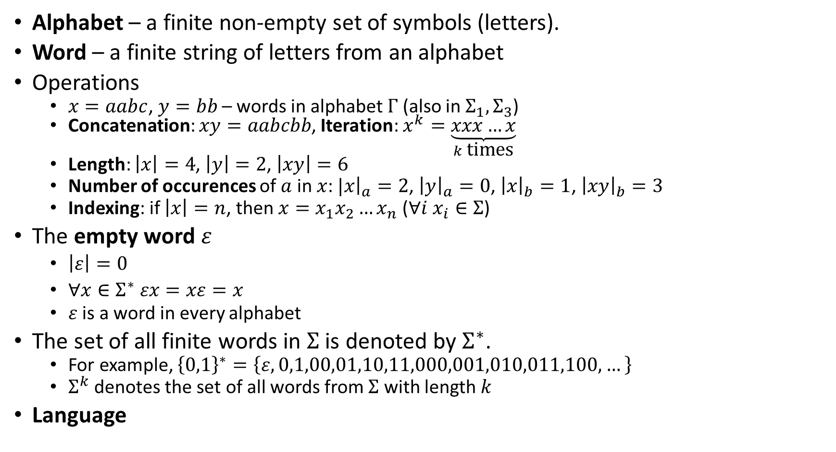
Alphabets, words, languages
$Σ_{1}=\left\{a,b,…,z\right\}$
$Σ_{2}=\left\{0,1\right\}$
$Σ_{3}=\left\{ a, ā, b, … z, ž, A, …, Ž, ␣, ., \left(, \right), …, ! \right\}$
$Σ_{4}=\left\{ ↑ , ↓ , → , ← \right\}$
$Γ =\left\{a,b,c\right\}$
Alphabet – a finite non-empty set of symbols (letters).
Word – a finite string of letters from an alphabet
Operations
$x=aabc$, $y=bb$ – words in alphabet $Γ$ (also in $Σ_{1},Σ_{3}$)
Concatenation: $xy=aabcbb$, Iteration: $x^{k}=\underset{k \text{times}}{\underbrace{xxx…x}}$
Length: $\left|x\right|=4$, $\left|y\right|=2$, $\left|xy\right|=6$
Number of occurences of $a$ in $x$: $|{\left.​x\right|}_{a}=2$, ${\left|y\right|}_{a}=0$, ${\left|x\right|}_{b}=1$, ${\left|xy\right|}_{b}=3$
Indexing: if $\left|x\right|=n$, then $x=x_{1}x_{2}…x_{n}$ ($∀i x_{i}∈Σ$)
The empty word $ε$
$\left|ε\right|=0$
$∀x∈Σ^{∗} εx=xε=x$
$ε$ is a word in every alphabet
The set of all finite words in $Σ$ is denoted by $Σ^{∗}$.
For example, ${\left\{0,1\right\}}^{∗}=\left\{ε,0,1,00,01,10,11,000,001,010,011,100,…\right\}$
$Σ^{k}$ denotes the set of all words from $Σ$ with length $k$
Language is a set of words. $L⊆Σ^{∗}$ denotes a language over alphabet $Σ$

Slide 14
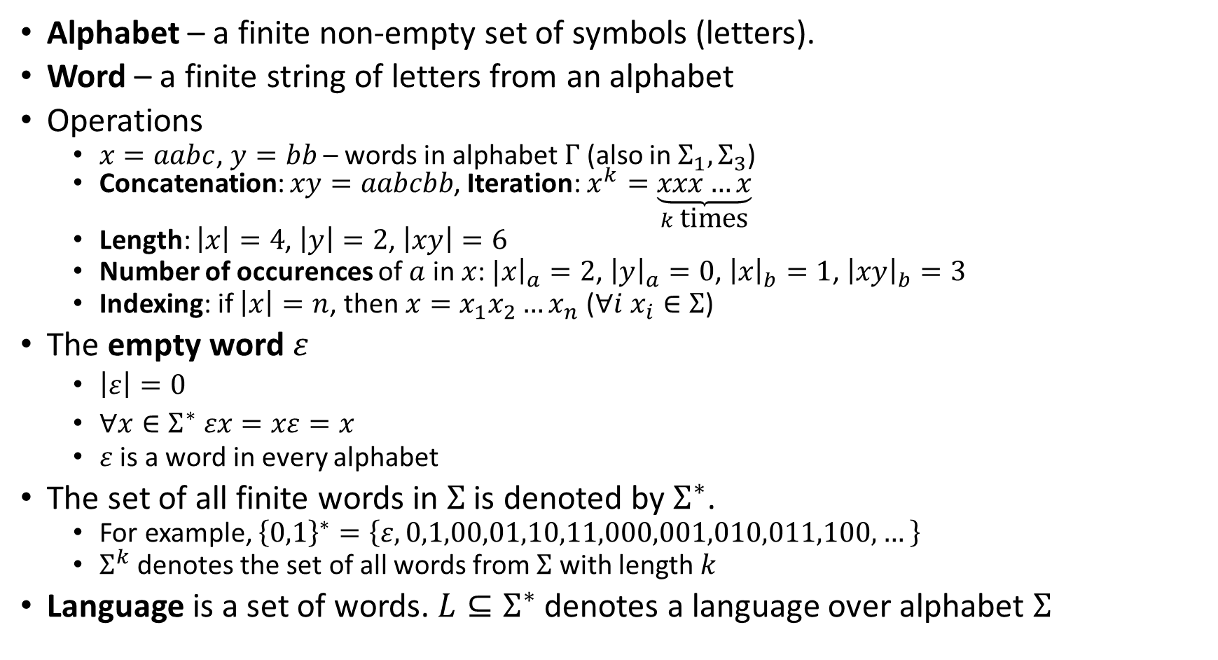
Alphabets, words, languages
$Σ_{1}=\left\{a,b,…,z\right\}$
$Σ_{2}=\left\{0,1\right\}$
$Σ_{3}=\left\{ a, ā, b, … z, ž, A, …, Ž, ␣, ., \left(, \right), …, ! \right\}$
$Σ_{4}=\left\{ ↑ , ↓ , → , ← \right\}$
$Γ =\left\{a,b,c\right\}$
Alphabet – a finite non-empty set of symbols (letters).
Word – a finite string of letters from an alphabet
Operations
$x=aabc$, $y=bb$ – words in alphabet $Γ$ (also in $Σ_{1},Σ_{3}$)
Concatenation: $xy=aabcbb$, Iteration: $x^{k}=\underset{k \text{times}}{\underbrace{xxx…x}}$
Length: $\left|x\right|=4$, $\left|y\right|=2$, $\left|xy\right|=6$
Number of occurences of $a$ in $x$: $|{\left.​x\right|}_{a}=2$, ${\left|y\right|}_{a}=0$, ${\left|x\right|}_{b}=1$, ${\left|xy\right|}_{b}=3$
Indexing: if $\left|x\right|=n$, then $x=x_{1}x_{2}…x_{n}$ ($∀i x_{i}∈Σ$)
The empty word $ε$
$\left|ε\right|=0$
$∀x∈Σ^{∗} εx=xε=x$
$ε$ is a word in every alphabet
The set of all finite words in $Σ$ is denoted by $Σ^{∗}$.
For example, ${\left\{0,1\right\}}^{∗}=\left\{ε,0,1,00,01,10,11,000,001,010,011,100,…\right\}$
$Σ^{k}$ denotes the set of all words from $Σ$ with length $k$
Language is a set of words. $L⊆Σ^{∗}$ denotes a language over alphabet $Σ$

Slide 15
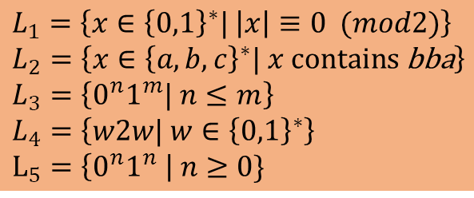
Alphabets, words, languages
$Σ_{1}=\left\{a,b,…,z\right\}$
$Σ_{2}=\left\{0,1\right\}$
$Σ_{3}=\left\{ a, ā, b, … z, ž, A, …, Ž, ␣, ., \left(, \right), …, ! \right\}$
$Σ_{4}=\left\{ ↑ , ↓ , → , ← \right\}$
$Γ =\left\{a,b,c\right\}$
Alphabet – a finite non-empty set of symbols (letters).
Word – a finite string of letters from an alphabet
Operations
$x=aabc$, $y=bb$ – words in alphabet $Γ$ (also in $Σ_{1},Σ_{3}$)
Concatenation: $xy=aabcbb$, Iteration: $x^{k}=\underset{k \text{times}}{\underbrace{xxx…x}}$
Length: $\left|x\right|=4$, $\left|y\right|=2$, $\left|xy\right|=6$
Number of occurences of $a$ in $x$: $|{\left.​x\right|}_{a}=2$, ${\left|y\right|}_{a}=0$, ${\left|x\right|}_{b}=1$, ${\left|xy\right|}_{b}=3$
Indexing: if $\left|x\right|=n$, then $x=x_{1}x_{2}…x_{n}$ ($∀i x_{i}∈Σ$)
The empty word $ε$
$\left|ε\right|=0$
$∀x∈Σ^{∗} εx=xε=x$
$ε$ is a word in every alphabet
The set of all finite words in $Σ$ is denoted by $Σ^{∗}$.
For example, ${\left\{0,1\right\}}^{∗}=\left\{ε,0,1,00,01,10,11,000,001,010,011,100,…\right\}$
$Σ^{k}$ denotes the set of all words from $Σ$ with length $k$
Language is a set of words. $L⊆Σ^{∗}$ denotes a language over alphabet $Σ$
$L_{1}=\left\{x∈{\left\{0,1\right\}}^{∗}| \left|x\right|≡0 (mod2)\right\}$
$L_{2}=\left\{x∈{\left\{a,b,c\right\}}^{∗}| x \text{contains} \text{bba}\right\}$
$L_{3}=\left\{0^{n}1^{m}| n≤m\right\}$
$L_{4}=\left\{w2w| w∈{\left\{0,1\right\}}^{∗}\right\}$
$L_{5}=\left\{0^{n}1^{n} \right| n≥0\}$

Slide 16

Alphabets, words, languages
$Σ_{1}=\left\{a,b,…,z\right\}$
$Σ_{2}=\left\{0,1\right\}$
$Σ_{3}=\left\{ a, ā, b, … z, ž, A, …, Ž, ␣, ., \left(, \right), …, ! \right\}$
$Σ_{4}=\left\{ ↑ , ↓ , → , ← \right\}$
$Γ =\left\{a,b,c\right\}$
Alphabet – a finite non-empty set of symbols (letters).
Word – a finite string of letters from an alphabet
Operations
$x=aabc$, $y=bb$ – words in alphabet $Γ$ (also in $Σ_{1},Σ_{3}$)
Concatenation: $xy=aabcbb$, Iteration: $x^{k}=\underset{k \text{times}}{\underbrace{xxx…x}}$
Length: $\left|x\right|=4$, $\left|y\right|=2$, $\left|xy\right|=6$
Number of occurences of $a$ in $x$: $|{\left.​x\right|}_{a}=2$, ${\left|y\right|}_{a}=0$, ${\left|x\right|}_{b}=1$, ${\left|xy\right|}_{b}=3$
Indexing: if $\left|x\right|=n$, then $x=x_{1}x_{2}…x_{n}$ ($∀i x_{i}∈Σ$)
The empty word $ε$
$\left|ε\right|=0$
$∀x∈Σ^{∗} εx=xε=x$
$ε$ is a word in every alphabet
The set of all finite words in $Σ$ is denoted by $Σ^{∗}$.
For example, ${\left\{0,1\right\}}^{∗}=\left\{ε,0,1,00,01,10,11,000,001,010,011,100,…\right\}$
$Σ^{k}$ denotes the set of all words from $Σ$ with length $k$
Language is a set of words. $L⊆Σ^{∗}$ denotes a language over alphabet $Σ$
$L_{1}=\left\{x∈{\left\{0,1\right\}}^{∗}| \left|x\right|≡0 (mod2)\right\}$
$L_{2}=\left\{x∈{\left\{a,b,c\right\}}^{∗}| x \text{contains} \text{bba}\right\}$
$L_{3}=\left\{0^{n}1^{m}| n≤m\right\}$
$L_{4}=\left\{w2w| w∈{\left\{0,1\right\}}^{∗}\right\}$
$L_{5}=\left\{0^{n}1^{n} \right| n≥0\}$
$00011∉L_{3}$
$ε∈L_{3}$

Slide 17

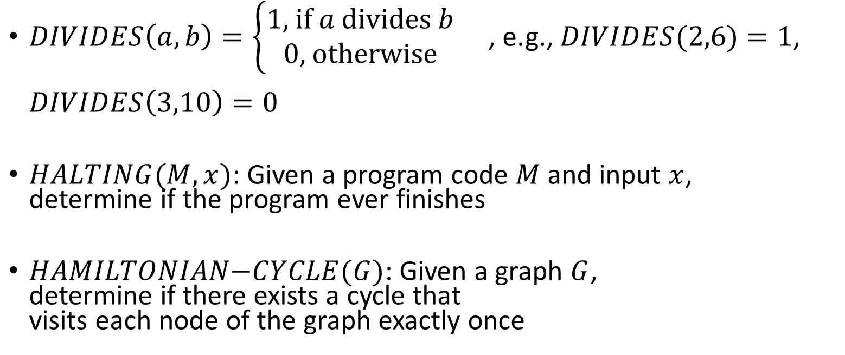
Some examples of decision problems
$DIVIDES\left(a,b\right)=\left\{\begin{aligned}1\text{, }\text{if} a \text{divides} b \\ 0\text{,} \text{otherwise}\end{aligned}\right.$ , e.g., $DIVIDES(2,6)=1$, $DIVIDES\left(3,10\right)=0$
$HALTING(M, x)$: Given a program code $M$ and input $x$, determine if the program ever finishes
$HAMILTONIAN\text{−}CYCLE(G)$: Given a graph $G$, determine if there exists a cycle that visits each node of the graph exactly once
Input: x
while (x > 1) {
if x is even:
x := x / 2
if x is odd:
x := 3x + 1
}
$x=29$ ?
$$29→88→44→22→11→34→17→52→…$$
1
2
Which of these problems are solvable by a computer?
Which of these are solvable reasonably fast?
3
4
5
6
7
8

Slide 18
Some examples of decision problems
$DIVIDES\left(a,b\right)=\left\{\begin{aligned}1\text{, }\text{if} a \text{divides} b \\ 0\text{,} \text{otherwise}\end{aligned}\right.$ , e.g., $DIVIDES(2,6)=1$, $DIVIDES\left(3,10\right)=0$
$HALTING(M, x)$: Given a program code $M$ and input $x$, determine if the program ever finishes
$HAMILTONIAN\text{−}CYCLE(G)$: Given a graph $G$, determine if there exists a cycle that visits each node of the graph exactly once
Input: x
while (x > 1) {
if x is even:
x := x / 2
if x is odd:
x := 3x + 1
}
$x=29$ ?
$$29→88→44→22→11→34→17→52→…$$
1
2
Which of these problems are solvable by a computer? A: 1, 3
It can be proven that no algorithm exists that would solve problem 2
Which of these are solvable reasonably fast? A: 1
There is no known fast (polynomial-time) algorithm for problem 3
3
4
5
6
7
8

Slide 19

Encoding larger alphabets
$Σ=\left\{a,b,c,d,e,f\right\}$
$Σ→\left\{0,1\right\}$
$a→000$
$b→001$
$c→010$
$d→011$
$e→100$
$f→101$
$adeb→000011100001$

Slide 20
Turing machine

Slide 21
Turing machine
More powerful model than finite automaton
Devised by Alan Turing in 1936
Extension to FA
(Potentially) infinite tape
Can move in both directions on the tape
Can read/write symbols on tape

Slide 22
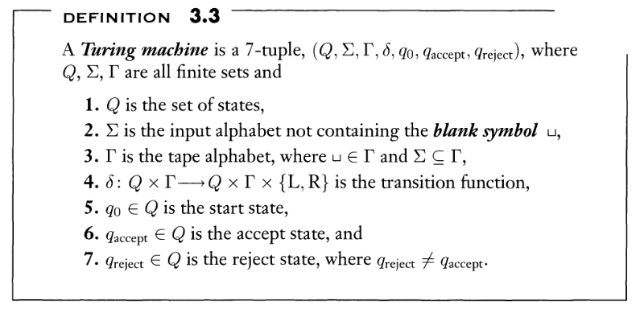

Slide 23
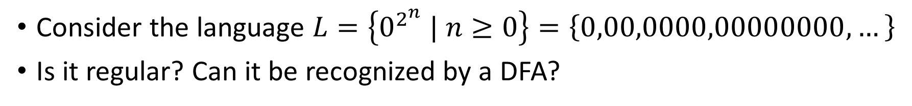
Example of a TM
Consider the language $L=\left\{0^{2^{n}} | n≥0\right\}=\left\{0,00,0000,00000000,…\right\}$
Is it regular? Can it be recognized by a DFA?

Slide 24
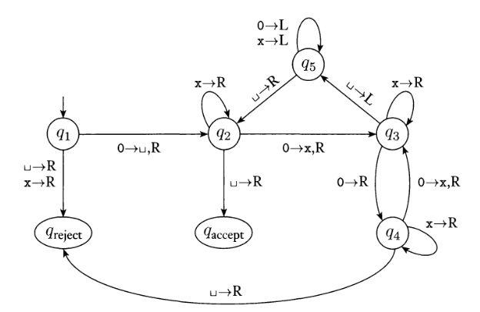

0
0
0
0
0
0
0
0
_
_
…
$$L=\left\{0^{2^{n}} | n≥0\right\}$$

Slide 25
0
0
0
0
0
0
0
0
_
_
…
$$L=\left\{0^{2^{n}} | n≥0\right\}$$

Slide 26

_
0
0
0
0
0
0
0
_
_
…
$$L=\left\{0^{2^{n}} | n≥0\right\}$$

Slide 27
_
x
0
0
0
0
0
0
_
_
…
$$L=\left\{0^{2^{n}} | n≥0\right\}$$

Slide 28
_
x
0
0
0
0
0
0
_
_
…
$$L=\left\{0^{2^{n}} | n≥0\right\}$$

Slide 29
_
x
0
x
0
0
0
0
_
_
…
$$L=\left\{0^{2^{n}} | n≥0\right\}$$

Slide 30
_
x
0
x
0
0
0
0
_
_
…
$$L=\left\{0^{2^{n}} | n≥0\right\}$$

Slide 31
_
x
0
x
0
x
0
0
_
_
…
$$L=\left\{0^{2^{n}} | n≥0\right\}$$

Slide 32
_
x
0
x
0
x
0
0
_
_
…
$$L=\left\{0^{2^{n}} | n≥0\right\}$$

Slide 33
_
x
0
x
0
x
0
x
_
_
…
$$L=\left\{0^{2^{n}} | n≥0\right\}$$

Slide 34
_
x
0
x
0
x
0
x
_
_
…
$$L=\left\{0^{2^{n}} | n≥0\right\}$$

Slide 35
_
x
0
x
0
x
0
x
_
_
…
$$L=\left\{0^{2^{n}} | n≥0\right\}$$

Slide 36
_
x
0
x
0
x
0
x
_
_
…
$$L=\left\{0^{2^{n}} | n≥0\right\}$$

Slide 37
_
x
0
x
0
x
0
x
_
_
…
$$L=\left\{0^{2^{n}} | n≥0\right\}$$

Slide 38
_
x
0
x
0
x
0
x
_
_
…
$$L=\left\{0^{2^{n}} | n≥0\right\}$$

Slide 39
_
x
0
x
0
x
0
x
_
_
…
$$L=\left\{0^{2^{n}} | n≥0\right\}$$

Slide 40
_
x
0
x
0
x
0
x
_
_
…
$$L=\left\{0^{2^{n}} | n≥0\right\}$$

Slide 41
_
x
x
x
0
x
0
x
_
_
…
$$L=\left\{0^{2^{n}} | n≥0\right\}$$

Slide 42
_
x
x
x
0
x
0
x
_
_
…
$$L=\left\{0^{2^{n}} | n≥0\right\}$$

Slide 43
_
x
x
x
0
x
0
x
_
_
…
$$L=\left\{0^{2^{n}} | n≥0\right\}$$

Slide 44
_
x
x
x
0
x
0
x
_
_
…
$$L=\left\{0^{2^{n}} | n≥0\right\}$$

Slide 45
_
x
x
x
0
x
x
x
_
_
…
$$L=\left\{0^{2^{n}} | n≥0\right\}$$

Slide 46
_
x
x
x
0
x
x
x
_
_
…
$$L=\left\{0^{2^{n}} | n≥0\right\}$$

Slide 47
_
x
x
x
0
x
x
x
_
_
…
$$L=\left\{0^{2^{n}} | n≥0\right\}$$

Slide 48
_
x
x
x
0
x
x
x
_
_
…
$$L=\left\{0^{2^{n}} | n≥0\right\}$$

Slide 49
_
x
x
x
0
x
x
x
_
_
…
$$L=\left\{0^{2^{n}} | n≥0\right\}$$

Slide 50
_
x
x
x
0
x
x
x
_
_
…
$$L=\left\{0^{2^{n}} | n≥0\right\}$$

Slide 51
_
x
x
x
0
x
x
x
_
_
…
$$L=\left\{0^{2^{n}} | n≥0\right\}$$

Slide 52
_
x
x
x
0
x
x
x
_
_
…
$$L=\left\{0^{2^{n}} | n≥0\right\}$$

Slide 53
_
x
x
x
x
x
x
x
_
_
…
$$L=\left\{0^{2^{n}} | n≥0\right\}$$

Slide 54
_
x
x
x
x
x
x
x
_
_
…
$$L=\left\{0^{2^{n}} | n≥0\right\}$$

Slide 55
_
x
x
x
x
x
x
x
_
_
…
$$L=\left\{0^{2^{n}} | n≥0\right\}$$

Slide 56
_
x
x
x
x
x
x
x
_
_
…
$$L=\left\{0^{2^{n}} | n≥0\right\}$$

Slide 57
_
x
x
x
x
x
x
x
_
_
…
$$L=\left\{0^{2^{n}} | n≥0\right\}$$

Slide 58
_
x
x
x
x
x
x
x
_
_
…
$$L=\left\{0^{2^{n}} | n≥0\right\}$$

Slide 59
_
x
x
x
x
x
x
x
_
_
…
$$L=\left\{0^{2^{n}} | n≥0\right\}$$

Slide 60
_
x
x
x
x
x
x
x
_
_
…
$$L=\left\{0^{2^{n}} | n≥0\right\}$$

Slide 61
_
x
x
x
x
x
x
x
_
_
…
$$L=\left\{0^{2^{n}} | n≥0\right\}$$

Slide 62
_
x
x
x
x
x
x
x
_
_
…
$$L=\left\{0^{2^{n}} | n≥0\right\}$$
0
0
0
0
0
0
0
0
Accepts

Slide 63
0
0
0
_
_
_
…
$$L=\left\{0^{2^{n}} | n≥0\right\}$$
0
0
0
0
0
0
0
0
Accepts

Slide 64
_
0
0
_
_
_
…
$$L=\left\{0^{2^{n}} | n≥0\right\}$$
0
0
0
0
0
0
0
0
Accepts

Slide 65
_
x
0
_
_
_
…
$$L=\left\{0^{2^{n}} | n≥0\right\}$$
0
0
0
0
0
0
0
0
Accepts

Slide 66
_
x
0
_
_
_
…
$$L=\left\{0^{2^{n}} | n≥0\right\}$$
0
0
0
0
0
0
0
0
Accepts

Slide 67
_
x
0
_
_
_
…
Rejects
$$L=\left\{0^{2^{n}} | n≥0\right\}$$
0
0
0
0
0
0
0
0
Accepts

Slide 68
_
x
0
_
_
_
…
$$L=\left\{0^{2^{n}} | n≥0\right\}$$
0
0
0
Rejects
0
0
0
0
0
0
0
0
Accepts

Slide 69
0
0
0
0
_
_
…
$$L=\left\{0^{2^{n}} | n≥0\right\}$$
0
0
0
Rejects
0
0
0
0
0
0
0
0
Accepts

Slide 70
_
0
0
0
_
_
…
$$L=\left\{0^{2^{n}} | n≥0\right\}$$
0
0
0
Rejects
0
0
0
0
0
0
0
0
Accepts

Slide 71
_
x
0
0
_
_
…
$$L=\left\{0^{2^{n}} | n≥0\right\}$$
0
0
0
Rejects
0
0
0
0
0
0
0
0
Accepts

Slide 72
_
x
0
0
_
_
…
$$L=\left\{0^{2^{n}} | n≥0\right\}$$
0
0
0
Rejects
0
0
0
0
0
0
0
0
Accepts

Slide 73
_
x
0
x
_
_
…
$$L=\left\{0^{2^{n}} | n≥0\right\}$$
0
0
0
Rejects
0
0
0
0
0
0
0
0
Accepts

Slide 74
_
x
0
x
_
_
…
$$L=\left\{0^{2^{n}} | n≥0\right\}$$
0
0
0
Rejects
0
0
0
0
0
0
0
0
Accepts

Slide 75
_
x
0
x
_
_
…
$$L=\left\{0^{2^{n}} | n≥0\right\}$$
0
0
0
Rejects
0
0
0
0
0
0
0
0
Accepts

Slide 76
_
x
x
x
_
_
…
$$L=\left\{0^{2^{n}} | n≥0\right\}$$
0
0
0
Rejects
0
0
0
0
0
0
0
0
Accepts

Slide 77
_
x
x
x
_
_
…
$$L=\left\{0^{2^{n}} | n≥0\right\}$$
0
0
0
Rejects
0
0
0
0
0
0
0
0
Accepts

Slide 78
_
x
x
x
_
_
…
$$L=\left\{0^{2^{n}} | n≥0\right\}$$
0
0
0
Rejects
0
0
0
0
0
0
0
0
Accepts

Slide 79
_
x
x
x
_
_
…
$$L=\left\{0^{2^{n}} | n≥0\right\}$$
0
0
0
Rejects
0
0
0
0
0
0
0
0
Accepts

Slide 80
_
x
x
x
_
_
…
$$L=\left\{0^{2^{n}} | n≥0\right\}$$
0
0
0
Rejects
0
0
0
0
0
0
0
0
Accepts

Slide 81
_
x
x
x
_
_
…
$$L=\left\{0^{2^{n}} | n≥0\right\}$$
0
0
0
0
Accepts
0
0
0
Rejects
0
0
0
0
0
0
0
0
Accepts

Slide 82
$$L=\left\{0^{2^{n}} | n≥0\right\}$$
0
0
0
0
0
0
0
0
0
0
0
0
0
0
0
0
_
_
0
0
0
0
Accepts
0
0
0
Rejects
0
0
0
0
0
0
0
0
Accepts

Slide 83
$$L=\left\{0^{2^{n}} | n≥0\right\}$$
_
x
0
x
0
x
0
x
0
x
0
x
0
x
0
x
_
_
0
0
0
0
Accepts
0
0
0
Rejects
0
0
0
0
0
0
0
0
Accepts

Slide 84
$$L=\left\{0^{2^{n}} | n≥0\right\}$$
_
x
0
x
0
x
0
x
0
x
0
x
0
x
0
x
_
_
0
0
0
0
Accepts
0
0
0
Rejects
0
0
0
0
0
0
0
0
Accepts

Slide 85
$$L=\left\{0^{2^{n}} | n≥0\right\}$$
_
x
0
x
0
x
0
x
0
x
0
x
0
x
0
x
_
_
0
0
0
0
Accepts
0
0
0
Rejects
0
0
0
0
0
0
0
0
Accepts

Slide 86
$$L=\left\{0^{2^{n}} | n≥0\right\}$$
_
x
x
x
0
x
x
x
0
x
x
x
0
x
x
x
_
_
0
0
0
0
Accepts
0
0
0
Rejects
0
0
0
0
0
0
0
0
Accepts

Slide 87
$$L=\left\{0^{2^{n}} | n≥0\right\}$$
_
x
x
x
x
x
x
x
0
x
x
x
x
x
x
x
_
_
0
0
0
0
Accepts
0
0
0
Rejects
0
0
0
0
0
0
0
0
Accepts

Slide 88
$$L=\left\{0^{2^{n}} | n≥0\right\}$$
_
x
x
x
x
x
x
x
x
x
x
x
x
x
x
x
_
_
0
0
0
0
Accepts
0
0
0
Rejects
0
0
0
0
0
0
0
0
Accepts

Slide 89
$$L=\left\{0^{2^{n}} | n≥0\right\}$$
_
x
x
x
x
x
x
x
x
x
x
x
x
x
x
x
_
_
0
0
0
0
Accepts
0
0
0
Rejects
0
0
0
0
0
0
0
0
Accepts

Slide 90
$$L=\left\{0^{2^{n}} | n≥0\right\}$$
_
x
x
x
x
x
x
x
x
x
x
x
x
x
x
x
_
_
16 → 8
8 → 4
4 → 2
2 → 1
1 → 0 → accept
0
0
0
0
Accepts
0
0
0
Rejects
0
0
0
0
0
0
0
0
Accepts

Slide 91
$$L=\left\{0^{2^{n}} | n≥0\right\}$$
0
0
0
0
0
0
0
0
0
0
0
0
0
0
0
0
_
_
16 → 8
8 → 4
4 → 2
2 → 1
1 → 0 → accept
0
0
0
0
0
0
_
_
6 → 3
3 → reject
0
0
0
0
Accepts
0
0
0
Rejects
0
0
0
0
0
0
0
0
Accepts

Slide 93



$$Q=\left\{q_{1},q_{2},q_{3},q_{4},q_{5}, q_{accept},q_{reject}\right\}$$
$$Σ=\left\{0\right\}$$
$$Γ=\left\{_,0,x\right\}$$
$$q_{0}=q_{1}$$

Slide 94
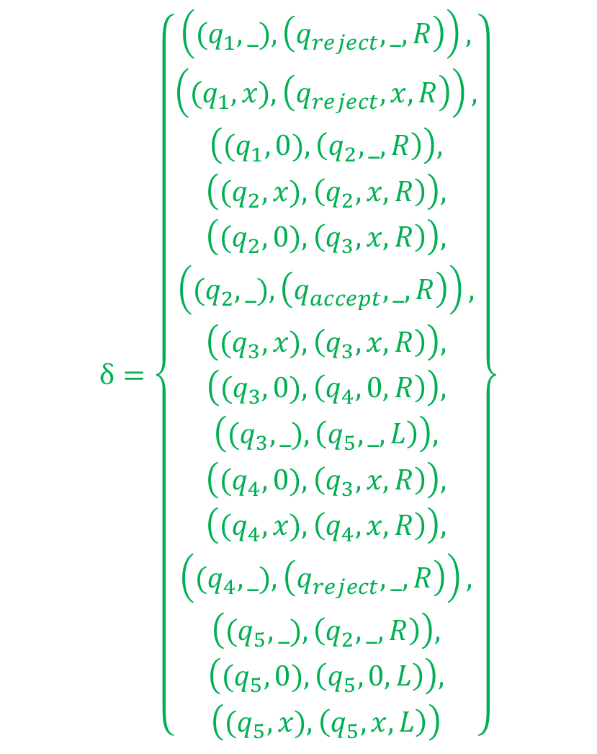
$$δ=\left\{\begin{aligned}\begin{aligned}\begin{aligned}\left({(q}_{1},_),\left(q_{reject},_,R\right)\right), \\ \left({(q}_{1},x),\left(q_{reject},x,R\right)\right),\end{aligned} \\ \begin{aligned}\left({(q}_{1},0),\left(q_{2},_,R\right)\right), \\ \left({(q}_{2},x),\left(q_{2},x,R\right)\right),\end{aligned} \\ \begin{aligned}\left({(q}_{2},0),\left(q_{3},x,R\right)\right), \\ \begin{aligned}\left({(q}_{2},_),\left(q_{accept},_,R\right)\right), \\ \left({(q}_{3},x),\left(q_{3},x,R\right)\right),\end{aligned}\end{aligned} \\ \left({(q}_{3},0),\left(q_{4},0,R\right)\right), \\ \left({(q}_{3},_),\left(q_{5},_,L\right)\right),\end{aligned} \\ \left({(q}_{4},0),\left(q_{3},x,R\right)\right), \\ \left({(q}_{4},x),\left(q_{4},x,R\right)\right), \\ \left({(q}_{4},_),\left(q_{reject},_,R\right)\right), \\ \left({(q}_{5},_),\left(q_{2},_,R\right)\right), \\ \left({(q}_{5},0),\left(q_{5},0,L\right)\right), \\ \left({(q}_{5},x),\left(q_{5},x,L\right)\right)\end{aligned}\right\}$$
$$Q=\left\{q_{1},q_{2},q_{3},q_{4},q_{5}, q_{accept},q_{reject}\right\}$$
$$Σ=\left\{0\right\}$$
$$Γ=\left\{_,0,x\right\}$$
$$q_{0}=q_{1}$$

Slide 95
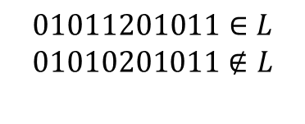
Build a TM that recognizes $L=\left\{w2w | w∈{\left\{0,1\right\}}^{∗}\right\}$
$$01011201011∈L$$
$$01010201011∉L$$

